Slide 1
Software Engineering I
Dr. Elham Mahmoudzadeh
Isfahan University of Technology
mahmoudzadeh@iut.ac.ir
2024

Slide 2
Chapter 4 Functional Modeling(II)

Slide 3
Steps(I)
Preparing proposal
Requirements determination
User story
Abstract Business Process Modelling
Analysis
Functional Modelling
Structural Modelling
Behavioral Modelling

Slide 4
Steps(II)
Design
Optimization
Database Management
User Interface
Physical Architecture

Slide 5
Business Process Modelling
Business process models describe the different activities that, when combined, support a business process.
From an object-oriented perspective, these processes cut across multiple roles.
Activity diagrams are used to model the behavior in a business process.

Slide 6
Activity diagram
It can be used to model everything from a high-level business workflow.
Can model a business process independent of any object implementation.
It can be used at a high level as well as at a low level of abstraction.
At a conceptual level, an activity is a task that needs to be done, whether by a human or a computer.
At an implementation level, an activity is a method or a class.

Slide 7
When to use an activity diagram
It should be used only when it adds value to the project.
Ask the following question: Does it add value or is it redundant?
An activity diagram can be used to accomplish the following tasks. 1. Depict the flow of control from activity to activity. 2. Help in use case analysis to understand what actions need to take place. 3. Help in identifying extensions in a use case. 4. Model work flow and business processes. 5. Model the sequential and concurrent steps in a computation process.

Slide 8
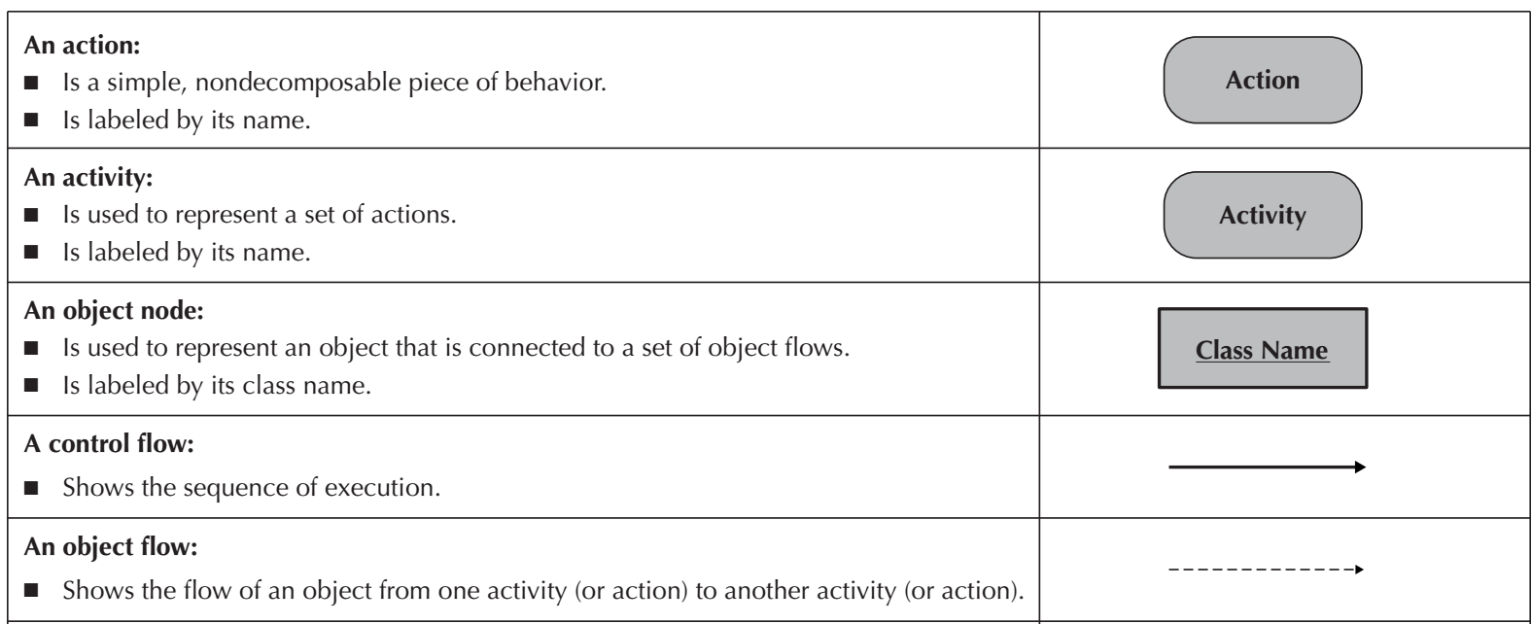
Elements of an Activity Diagram(I)

Slide 9
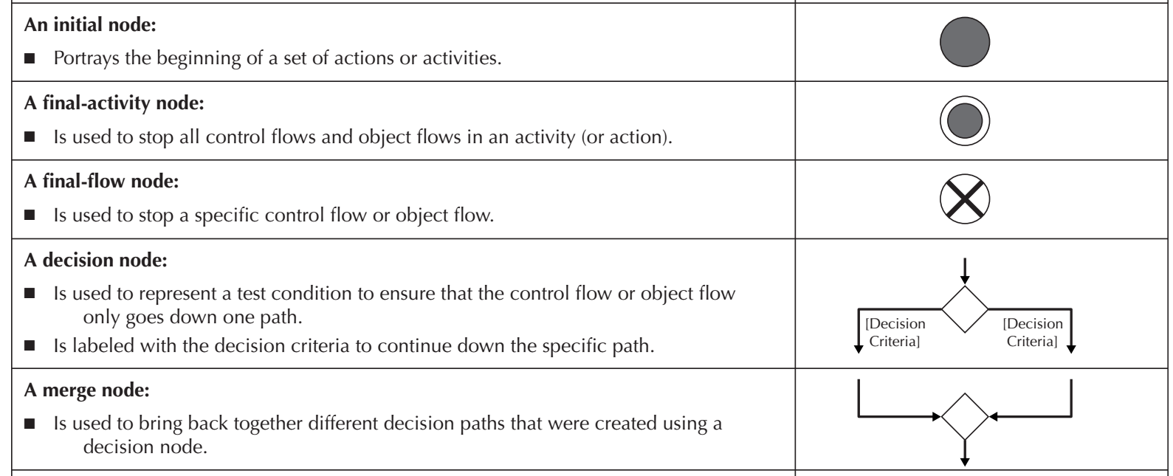
Elements of an Activity Diagram(II)

Slide 10
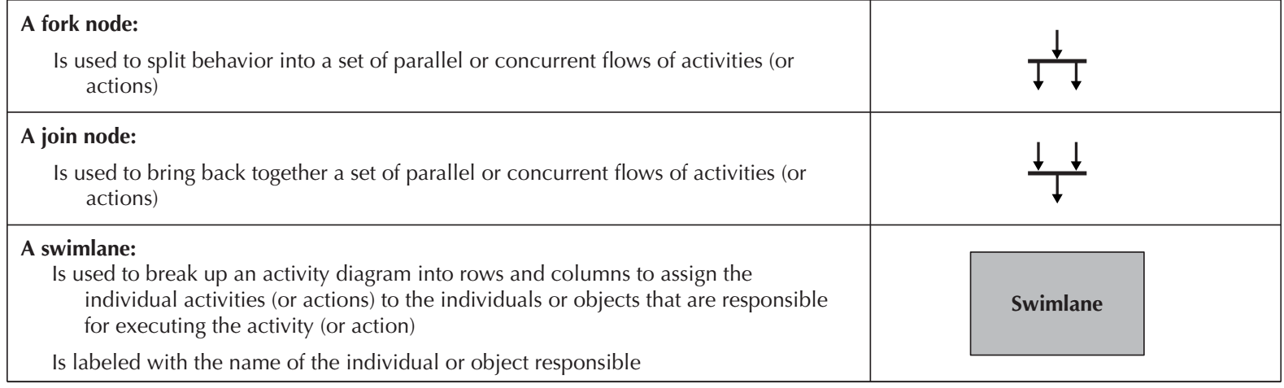
Elements of an Activity Diagram(III)

Slide 11
Actions and Activities
Can represent manual or computerized behavior.
Depicted in an activity diagram as a rounded rectangle.
They should have a name that begins with a verb and ends with a noun (e.g., Get Patient Information)
Names should be short, yet contain enough information so that the reader can easily understand exactly what they do.
The only difference between an action and an activity is that an activity can be decomposed further into a set of activities and/or actions, whereas an action represents a simple non-decomposable piece of the overall behavior being modeled.
In most cases, each activity is associated with a use case.

Slide 12
Control Flows
Control flows model the paths of execution through a business process.
A control flow is portrayed as a solid line with an arrowhead on it showing the direction of flow.
Control flows can be attached only to actions or activities.

Slide 13
Initial node
Portrays the beginning of a set of actions or activities.
Is shown as a small filled-in circle.

Slide 14
final-activity node
Is used to stop the process being modeled.
Any time a final-activity node is reached, all actions and activities are ended immediately, regardless of whether they are completed.
Is represented as a circle surrounding a small, filled-in circle.

Slide 15
Final-flow node
Is similar to a final-activity node, except that it stops a specific path of execution through the business process but allows the other concurrent or parallel paths to continue.
Is shown as a small circle with an X in it.

Slide 16
Decision node
Is used to represent the actual test condition that determines which of the paths exiting the decision node is to be traversed.
In this case, each exiting path must be labeled with a guard condition.
A guard condition represents the value of the test for that particular path to be executed.

Slide 17
Merge node
Is used to bring back together multiple mutually exclusive paths that have been split based on earlier.
However, sometimes, for clarity, it is better not to use a merge node.

Slide 18
Fork and Join nodes
The fork and join nodes allow parallel and concurrent processes to be modeled .
The fork node is used to split the behavior of the business process into multiple parallel or concurrent flows. Unlike the decision node, the paths are not mutually exclusive.
The join node simply brings back together the separate parallel or concurrent flows in the business process into a single flow.

Slide 19
Swimlanes
However, there are times when it helps to break up an activity diagram in such a way that it can be used to assign responsibility to objects or individuals who would actually perform the activity. This is especially useful when modeling a business workflow and is accomplished through the use of swimlanes.

Slide 20
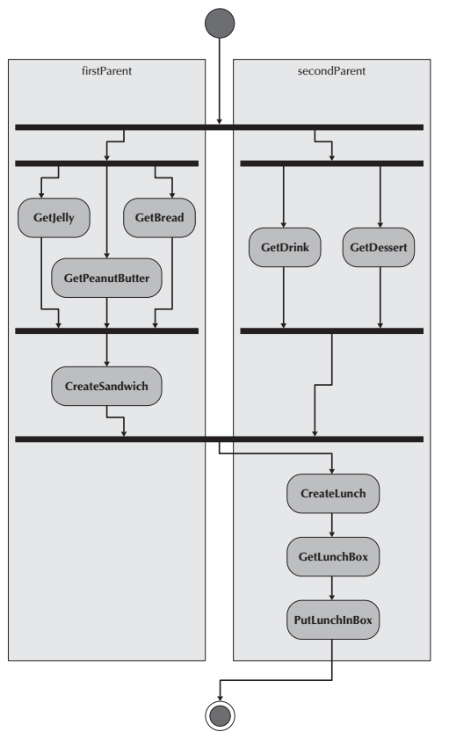

Slide 21
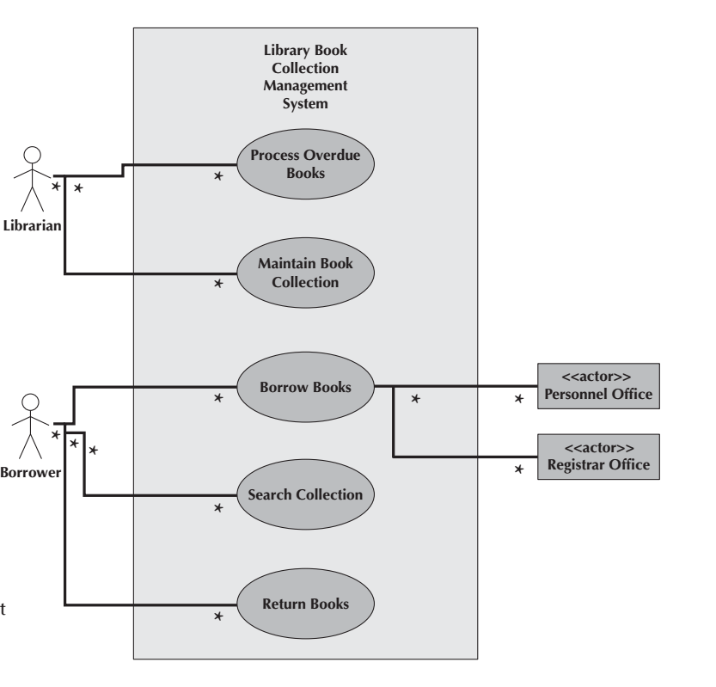

Slide 22
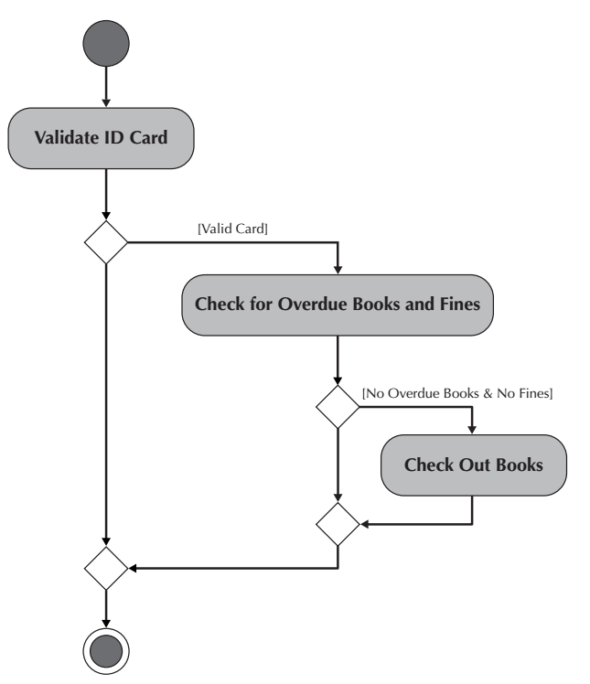

Slide 23
Object nodes
Activities and actions typically modify or transform objects. Object nodes model these objects in an activity diagram.
The name of the class of the object is written inside the rectangle.
Essentially, object nodes represent the flow of information from one activity to another activity.

Slide 24
Object Flows
Object flows model the flow of objects through a business process.
Because activities and actions modify or transform objects, object flows are necessary to show the actual objects that flow into and out of the actions or activities.
An object flow is depicted as a dashed line with an arrowhead on it showing the direction of flow.
An individual object flow must be attached to an action or activity on one end and an object node on the other end.

Slide 25
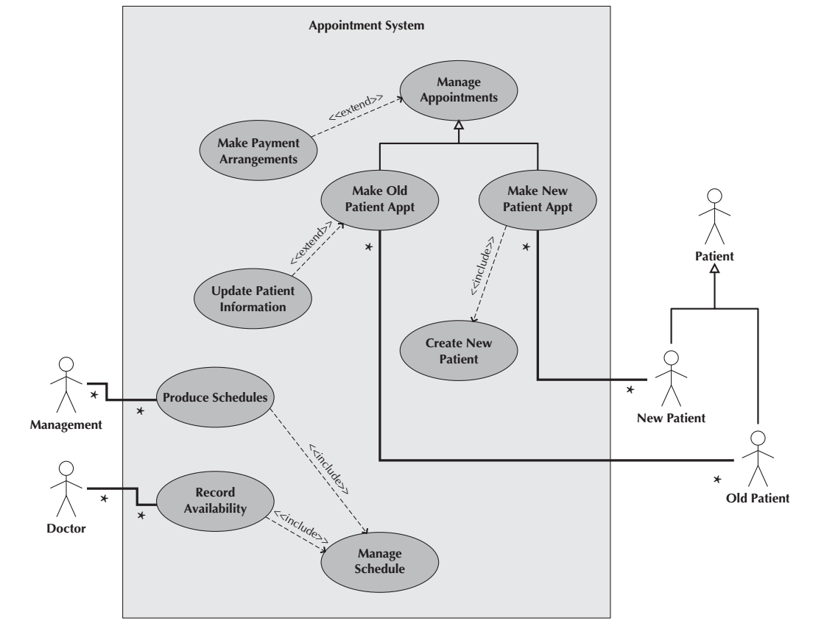

Slide 26
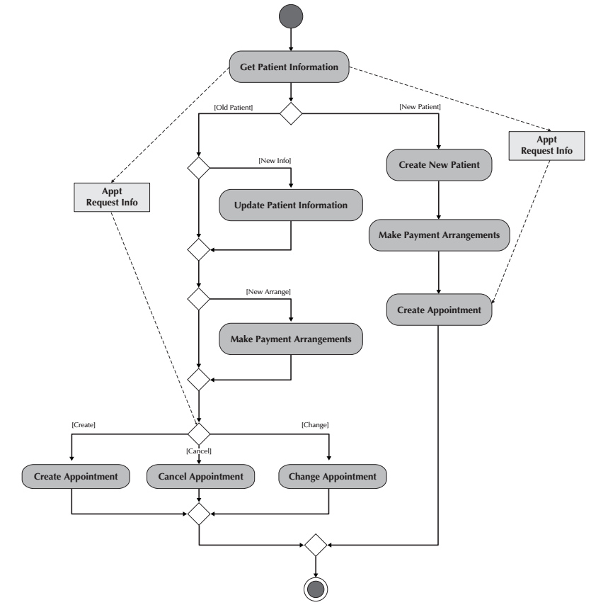

Slide 27
Control Nodes
Initial,
Final-activity,
Final-flow,
Decision,
Merge,
Fork,
Join

Slide 28
What should you do for your project?
Create Activity diagram.
We will work in the lab.

Slide 29
Reference
Dennis, Wixon, Tegarden, “System Analysis and Design, An Object Oriented Approach with UML”, 5th Edition, 2015.
Valacich, J. S., J. F. George, “Modern systems analysis and design”, 8th Edition, 2017.

